Slide 1
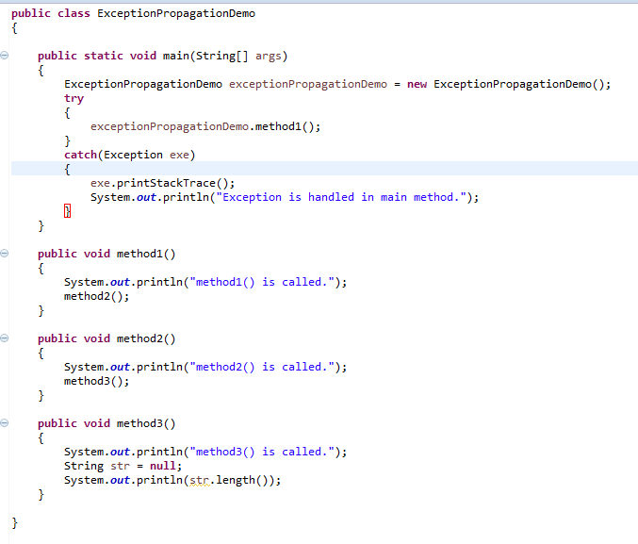
Java Exception propagation
Top of the Call stack
method3()
method2()
method1()
main()
Exception
occurred
Bottom of the Call stack
Call stack
In this example exception occurs in method3() where it is not handled, so it is propagated to method2 where it is not handled, again it is propagated to method1() where exception is not handled, again it is propagated to main() method where exception is handled.
Exception can be handled in any method in call stack either in method3(), method2() method1() or main() method.

Slide 2
Java Exception propagation
An exception is first thrown from the top of the stack and if it is not caught, it drops down the call stack to the previous method, If not caught there, the exception again drops down to the previous method, and so on until they are caught or until they reach the very bottom of the call stack.This is called exception propagation.

